Slide 1
Market Trend Classification
McKinnon, William

Slide 2
Problem Statement
Goal is to predict overall trend for a given sector or Index (Dow Jones Industrial Average)

Slide 3
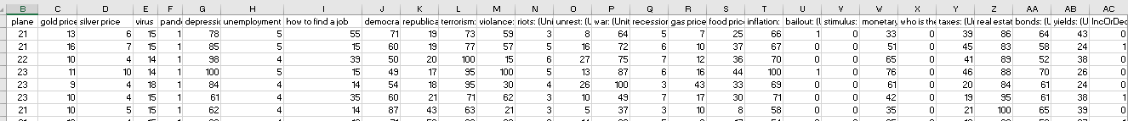
Dataset
Data was focused on google trends results to see if it could be used to classify whether or not the market (DowJones) would go up or down.
29 Columns.
209 rows.
Data spans 2004 – present in one month intervals.
Target data was there a month to month Increase or Decrease.
20% Test
20% Validation

Slide 4
Approach
Numerical encoding
Deep wide & Cross network
Neural decision forest

Slide 5
Deep & Cross network.
Benefits
Generate interactions implicitly
Deep network is a stack of fully connected (Dense) layers with ReLU activation function.
Each layer of a cross network is a linear model added.
Outputs from Deep and cross are concatened and fed into standard logit layer.
Learning rate = 0.00001
Dropout rate = 0.1
Epochs = 300
Hidden_Units = [32, 32]
Encoding_size = 16

Slide 6
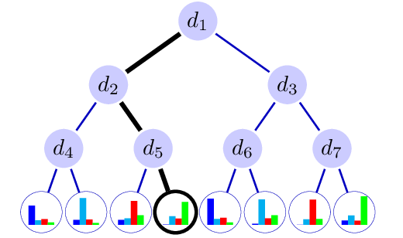
Neural Decision Forest
Neural decision tree learns two sets of weights
Probability distribution of classes in the tree leave
Routing decision layer which represents the probability of going to each leaf
A forest is several trees that are trained together.
Depth = 10
Number of trees = 10
classesUsed = .7

Slide 7
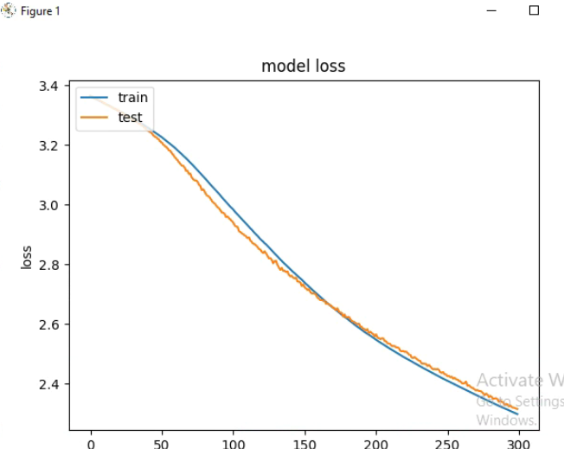
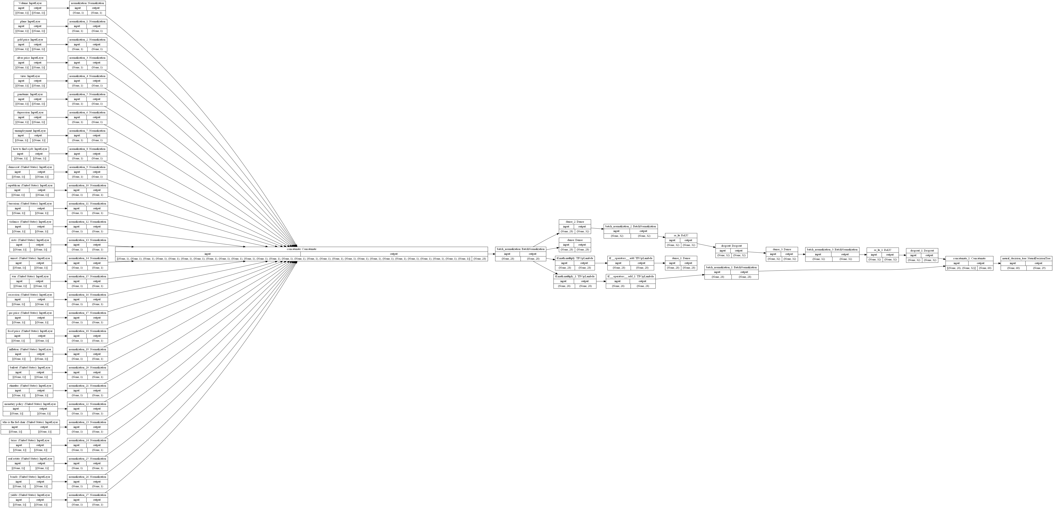
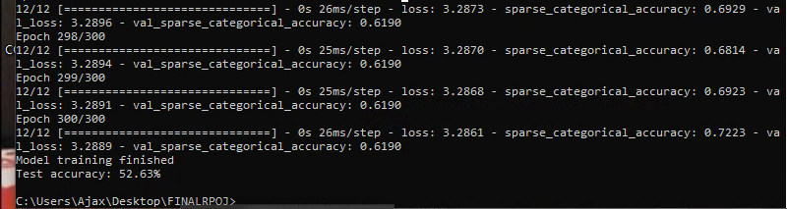
Model Attempt Final

Slide 8
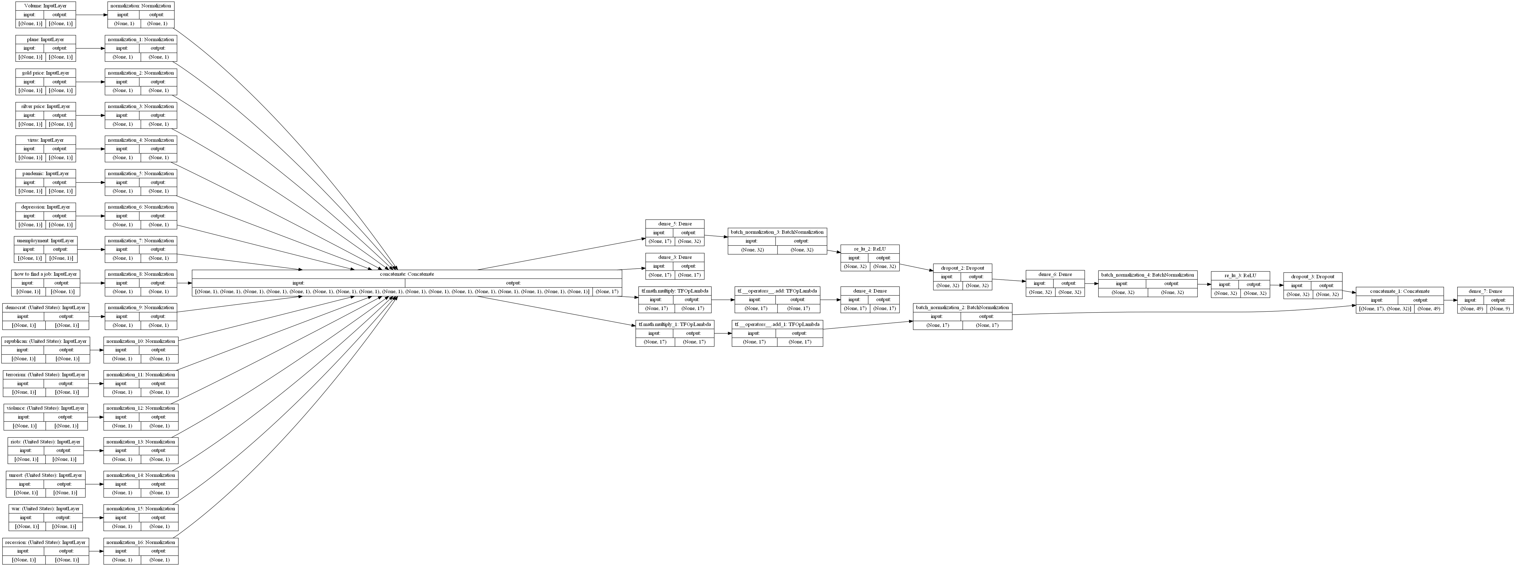
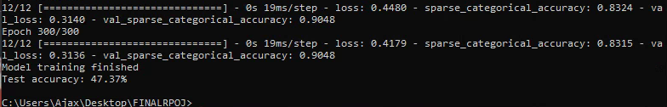
Model Attempt Two

Slide 9
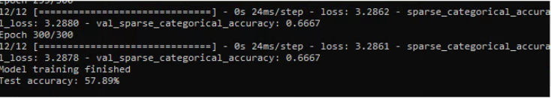

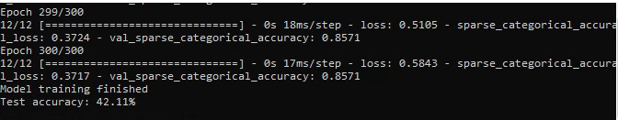
Results:
Results
Best result: Final Model Dataset2 63.16%
Larger dataset appears to yield better results. I wonder if there is a limit though to the effectiveness of new data .
Best result: Final Model 57.89%
Model Attempt Two:
Model Attempt One:

Slide 10
Results:
Future plans
Automate the data acquisition portion to generate a much larger data set.

